Slide 1
Humanitarian App Development
3/3/2020
Sarah Akbar, Daniel Alvarado, Veronica Gurnawan, Nathan Walzer

Slide 2
Weekly Overview
Set up routes for application
Set up login/register account functionality
Developed spreadsheet script to load into Firebase automatically
Developed heatmap and proximity map visualization prototypes
Security update
Reworked and redeployed surveys
More success!
Notes:
Veronica

Slide 3
Application update
Basic login/registration functionality
Protected routes
First iteration of heatmap
Notes:
Veronica

Slide 4
Database update
Spreadsheet script
Populates firestore database from a CSV
Needs to be updated to prevent repeat entries
Notes:
Veronica

Slide 5
Data Visualization update
Current progress on the data visualizations
Notes:
Veronica

Slide 6
Security update
Frontend has the ability to determine if user is logged in before displaying components (protected routes)
Threat modeling
Data sanitization for account registration (Server-side only for now)
Firestore security rules updated for resource data
Notes:
Veronica

Slide 7
Survey update
Condensed survey and redeployed it
Many more responses than the initial deployment
Will continue distribution
Notes:
Veronica

Slide 8
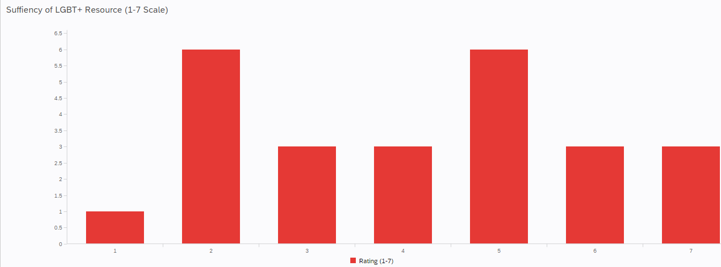
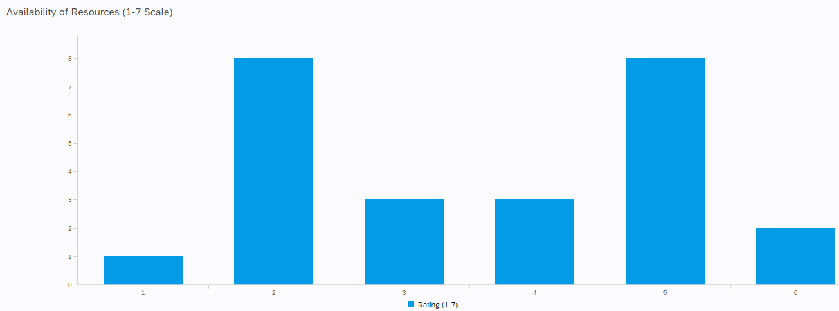

Slide 9
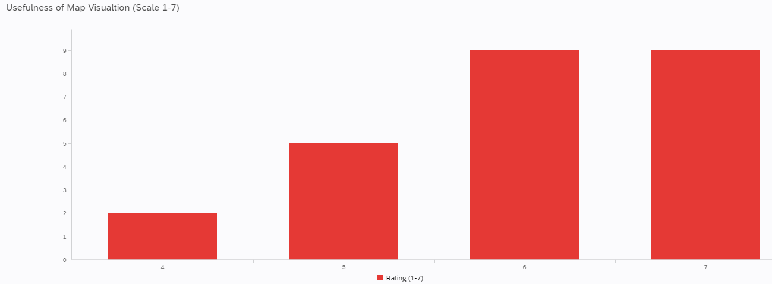
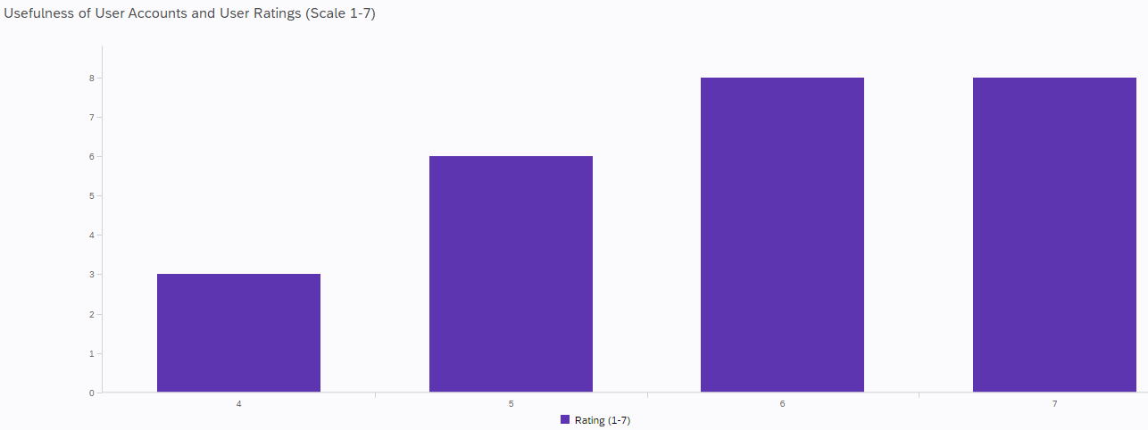

Slide 10
Overall Objectives for the next Week:
Have feature-complete app prototype
Including data vis and user review feature
Continue survey deployment and begin results final draft
Notes:
By establishing the background for our project, we can understand the problem surrounding LGBT resources and justify the need for our proposed solution.

Slide 11
Goal 1: Have feature-complete app prototype
Have fully functioning data visualizations with updating geographic data
Set up all routes, protected and public
Set up user reviews functionality
Fully working UI
Notes:
DJ

Slide 12
Goal 2: Continue survey deployment and begin results final draft
Continue survey deployment to the mid-week point of next week, then use observations collected to develop the results final draft
Notes:
Sarah

